Slide 1
Sentimental Analysis on Movie Reviews Unveiling Audience Perspectives in the Film Industry
12/09/2023
2
#1

Slide 2
In Today’s movie
Objective
Scope
Methods
Results
Conclusions
Work
01
02
03
04
05
06

Slide 3
Explore sentiment in movie reviews using advanced NLP techniques.
objective
Sentiment Analysis: Analyzing audience sentiments in IMDb reviews.
Informing Filmmakers: Providing insights for more audience-centric content.
Genre Patterns: Examining sentiment trends in specific movie genres.
Impact on Ratings: Investigating sentiments' correlation with IMDb ratings.

Slide 4
What is the Scope?
Relevant & Valuable
Audience Insights , Perception Understanding , Informed Filmmaking , Effective Marketing
Box Office Impact , Boost Sales , Precision Marketing , Targeted Promotion

Slide 5
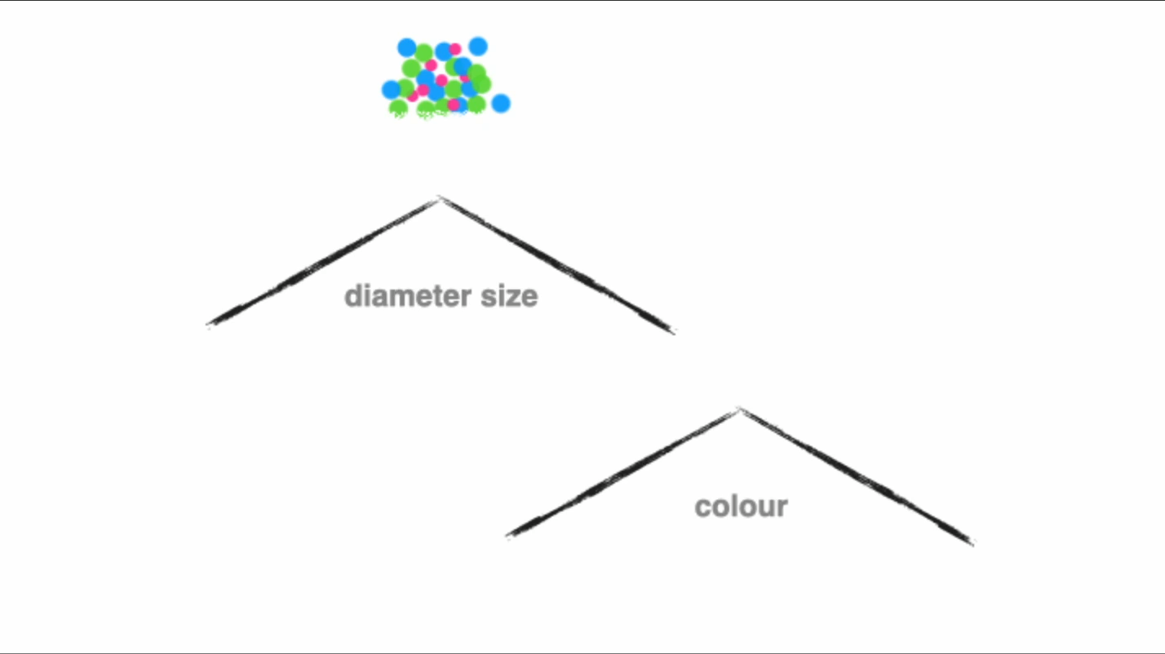
Methodologies
Decision Tree
Naive Bayes
Neural Networks
SVM
XGBoost.
Decision Tree

Slide 6
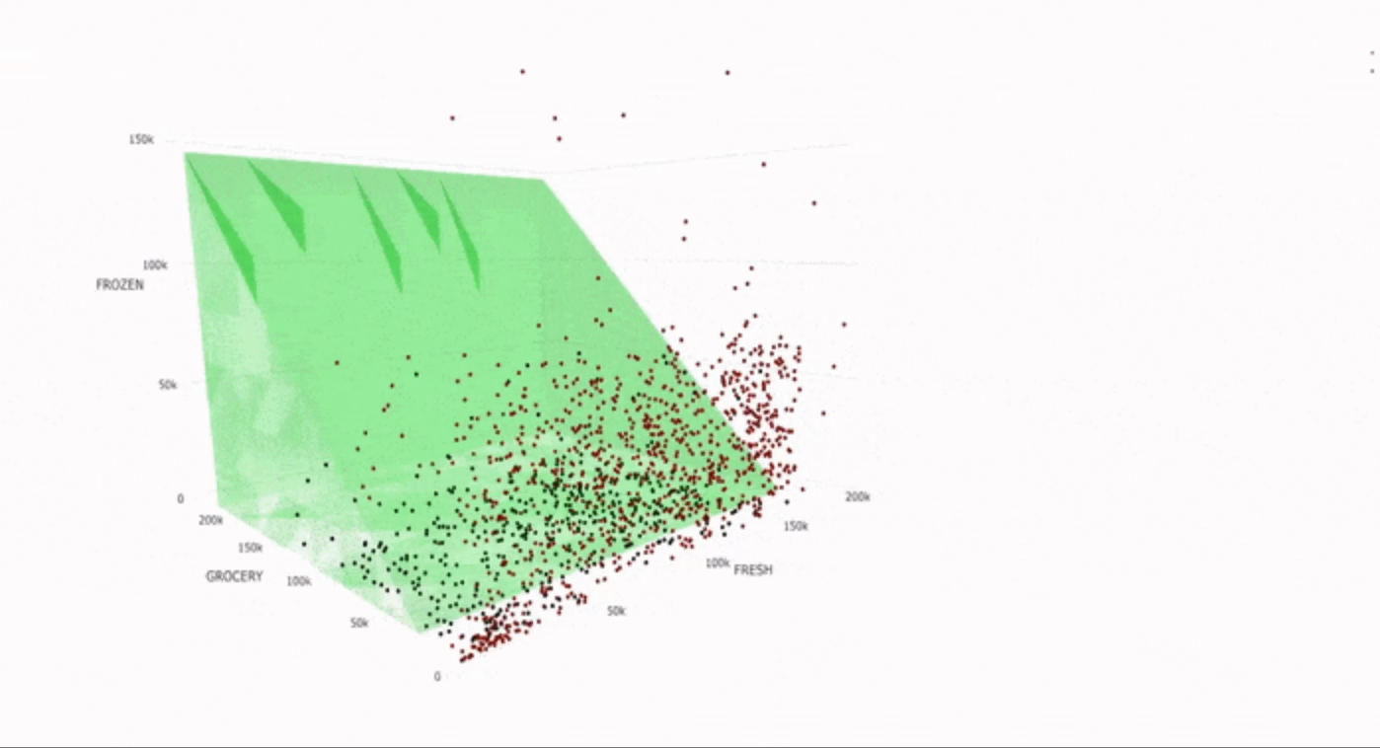
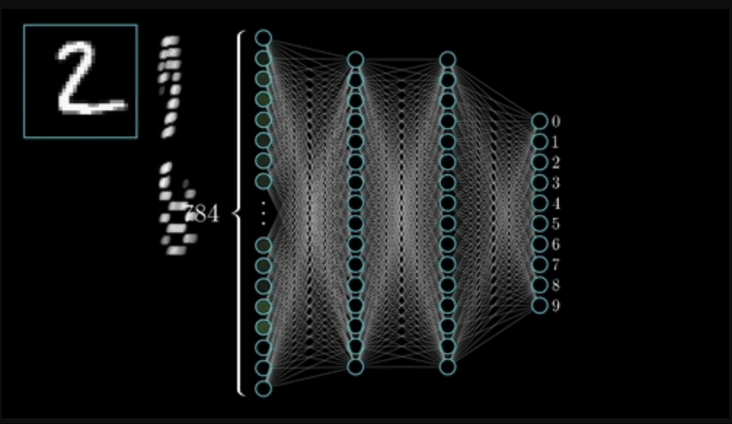
Methodologies
Naïve bayes
Neural network

Slide 7
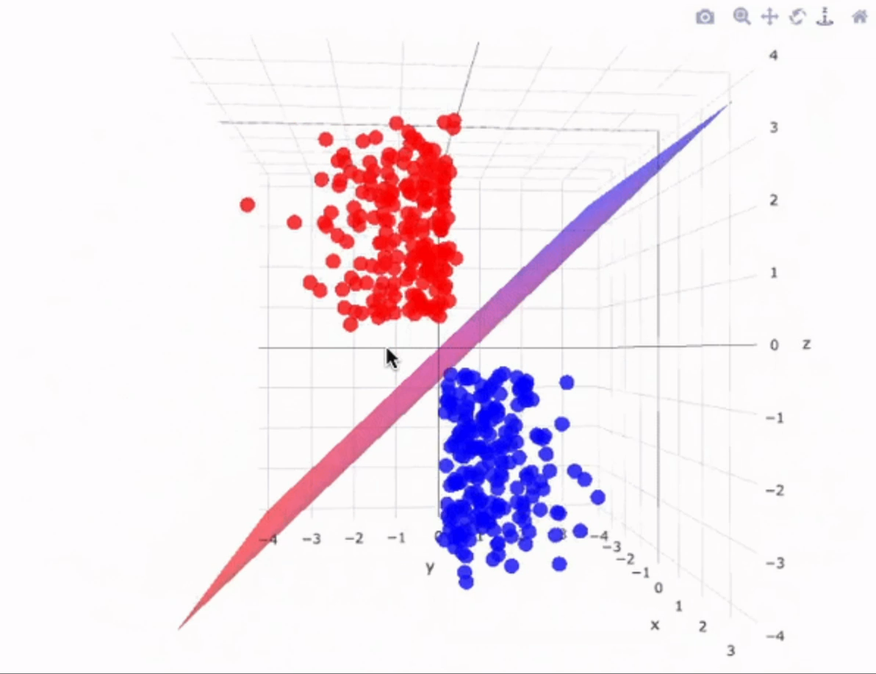
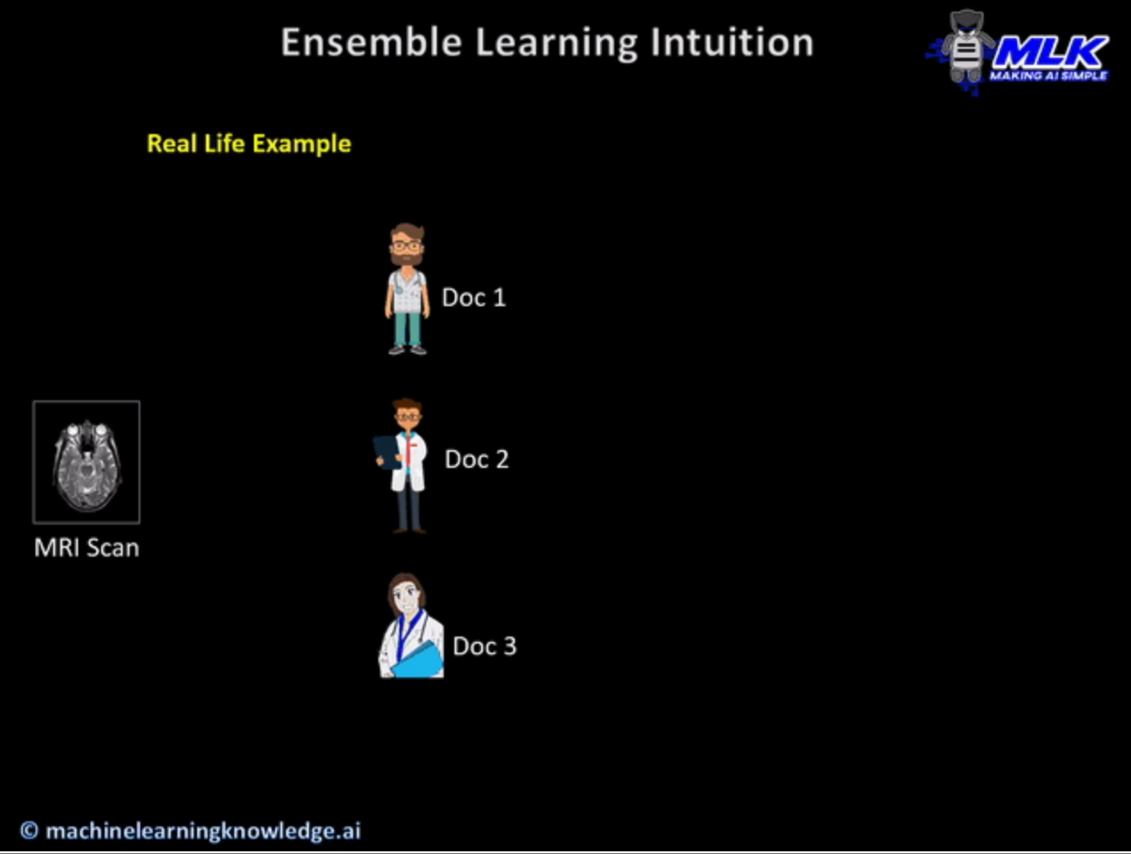
Methodologies
SVM
Xgboost

Slide 8
=> The main corner that we touch for any of the predictions is with a dataset. -> Imdb dataset => Text cleaning: Cleaning up words: Making sure the words make sense for our computers => Tokenization: Breaking into Words: Turning sentences into individual words, making it easier for the computer to understand => Vectorization: Turning Words into Numbers: Converting words into numerical vectors so our computer models can process and analyze them => Seeing if our models are right: We're using some measurements like accuracy, precision, recall, and F1 score to check.
Data Pre-processing

Slide 9
Methodologies:
Neural Network:
A neural network is a method in artificial intelligence that teaches computers to process data in a way that is inspired by the human brain. It is a type of machine learning process, called deep learning, that uses interconnected nodes or neurons in a layered structure that resembles the human brain. We have implemented a simple single hidden layer in our implementation.
Naïve Bayes:
Naïve Bayes is a simple learning algorithm that utilizes Bayes rule together with a strong assumption that the attributes are conditionally independent.
SVM:
A support vector machine (SVM) is a type of supervised learning algorithm used in machine learning to solve classification and regression tasks; SVMs are particularly good at solving binary classification problems, which require classifying the elements of a data set into two groups.

Slide 10
Methodologies:
Decision Tree:
A decision tree is a non-parametric supervised learning algorithm, which is utilized for both classification and regression tasks. we have used decision tree for sentiment analysis in movie reviews by learning patterns and making decisions based on features extracted from the text data.
XGBOOST:
XGBoost stands for Extreme Gradient Boosting, which is scalable and highly accurate. The steps included are Data Preparing, Data preprocessing in which we preprocessed and cleaned our text data(IMDB dataset), Feature extraction in which we convert our text data into numerical form that our model can understand(like Bag of words or TF-IDF) we used TF-IDF, Then we split our data into test data and training dataset, then training the XGBoost Classifier, then evaluating the model and making predictions and then visualising the data.

Slide 11
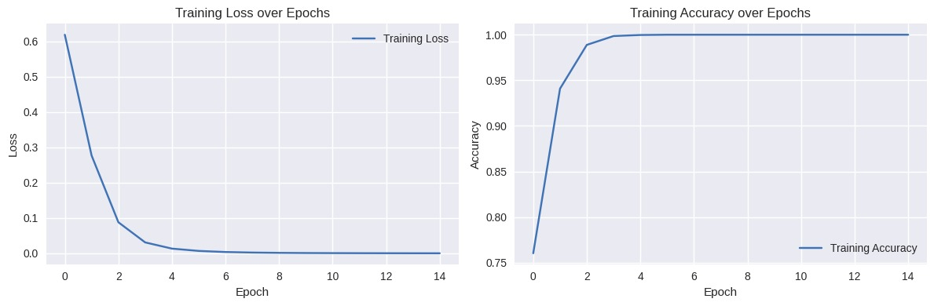
Results:
Neural Network:

Slide 12
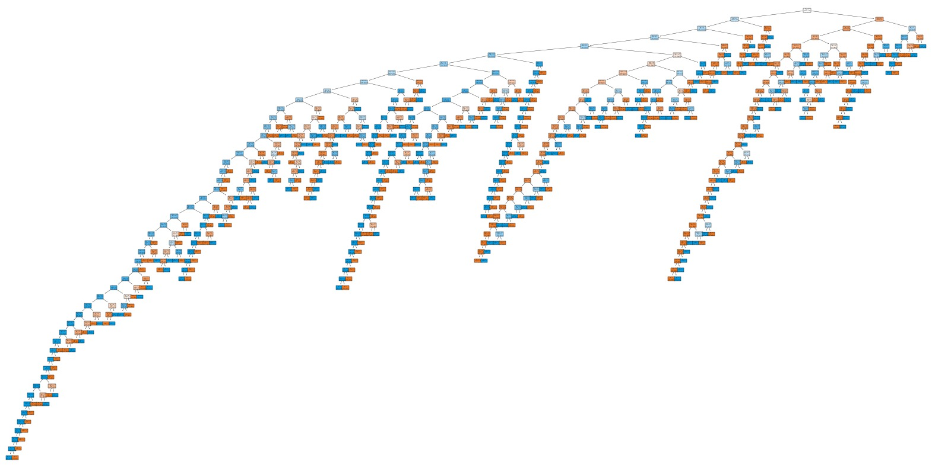
Results:
Decision Tree:

Slide 13
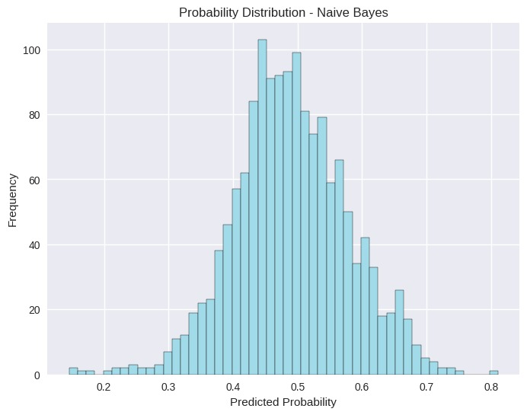
Results:
Naïve Bayes:

Slide 14
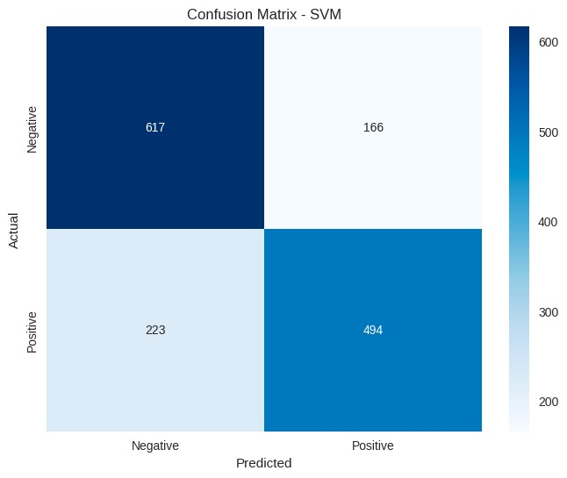
Results:
SVM:

Slide 15
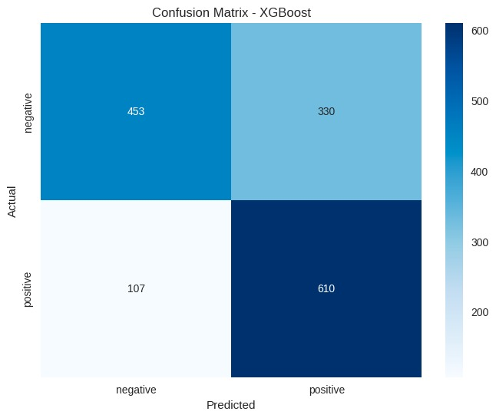
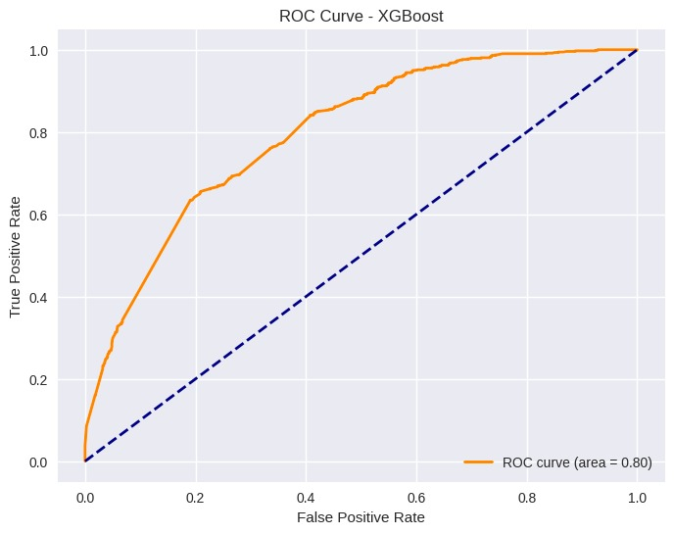
Results:
XgBoost:

Slide 16
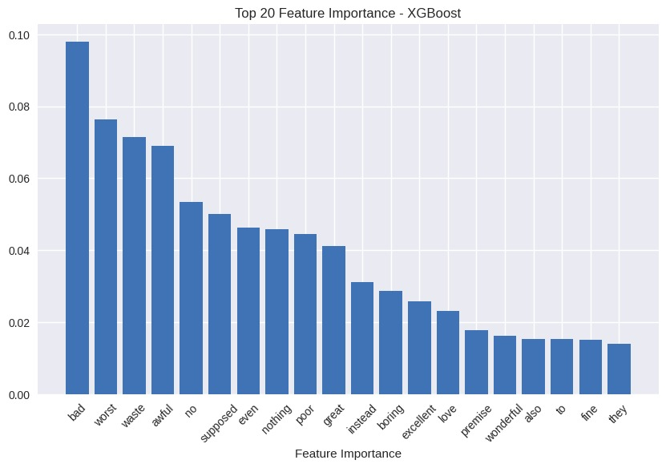
Results:
XGBOOST

Slide 17
Final Results
This is where you section ends. Duplicate this set of slides as many times you need to go over all your sections.

Slide 18
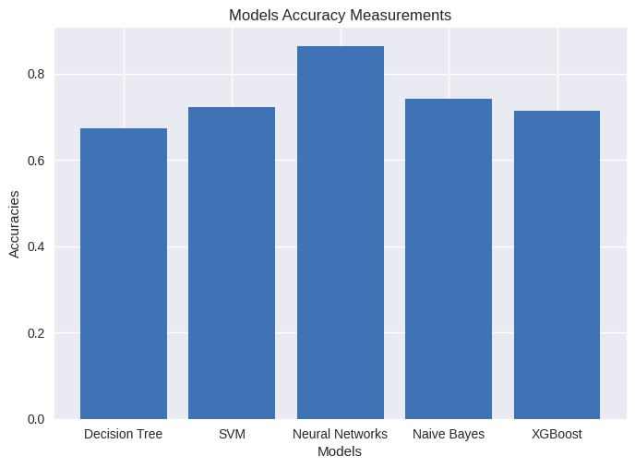

Slide 19
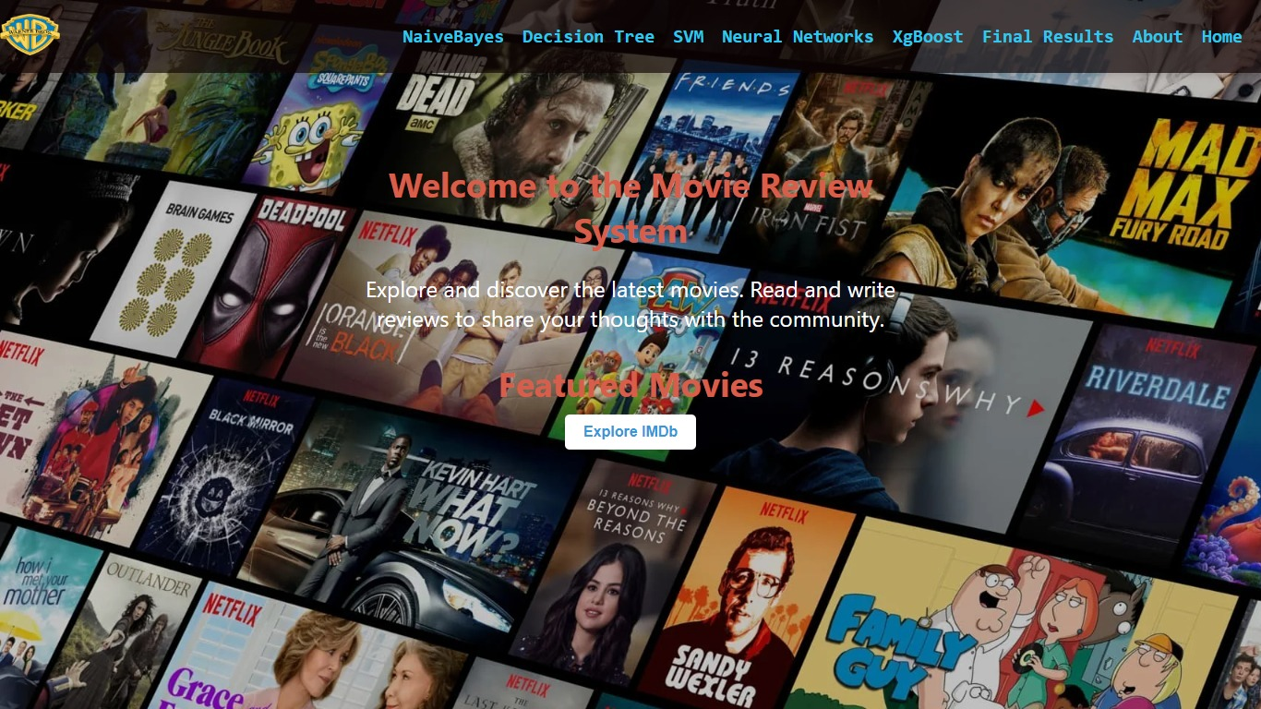

Slide 20
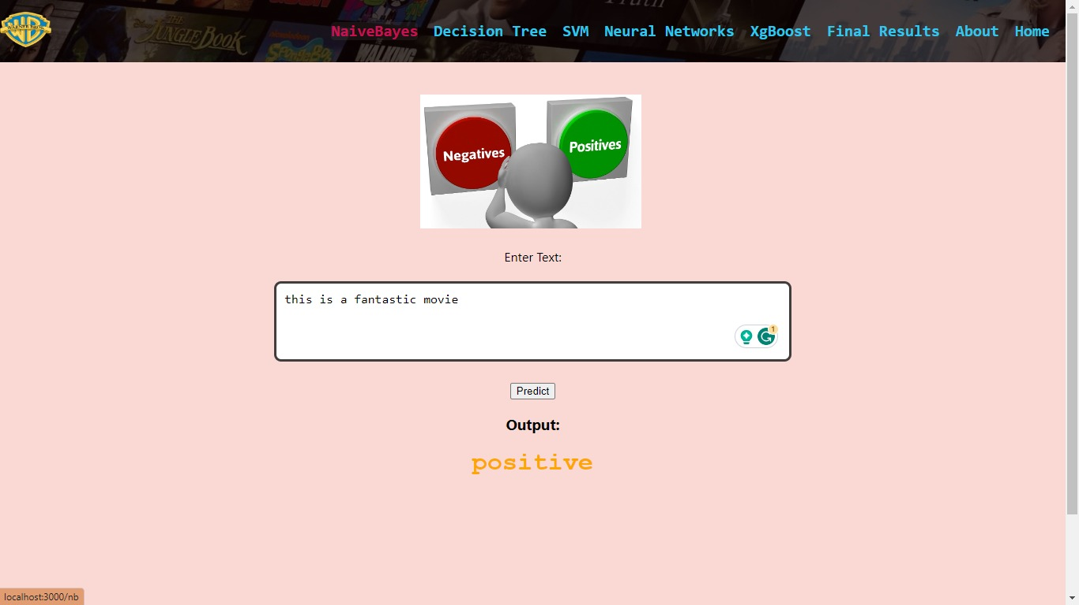

Slide 21
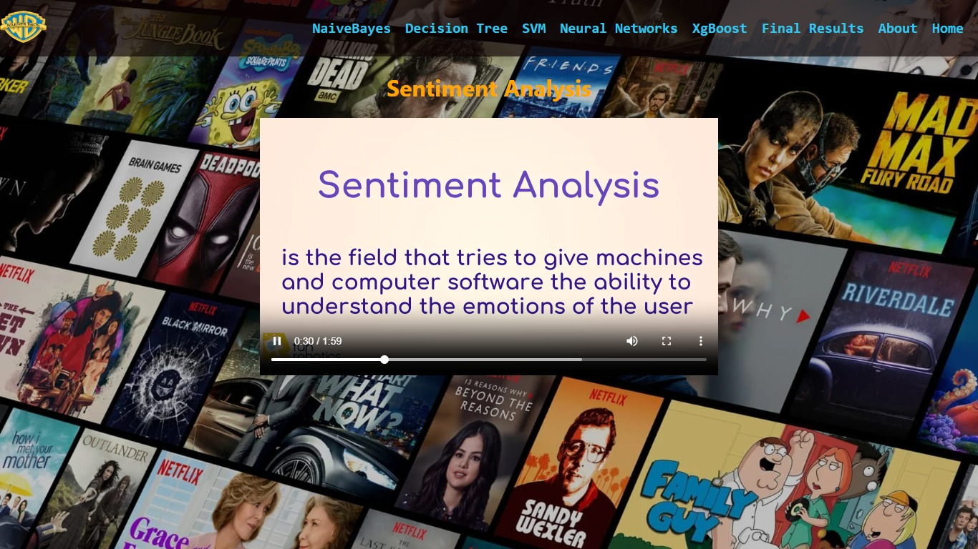

Slide 22
References:
Below are the references:
https://pythonspot.com/nltk-stop-words/
https://www.kaggle.com/code/gokhankesler/best-i-can-do-with-sklearn/notebook
https://stackoverflow.com/questions/9662346/python-code-to-remove-html-tags-from-a-string
https://www.linkedin.com/pulse/building-sentiment-analysis-model-nltk-xgboost-ashkan-kardan/
https://scholar.smu.edu/cgi/viewcontent.cgi?article=1205&context=datasciencereview
https://www.cs.cornell.edu/home/llee/papers/sentiment.pdf
https://www.ripublication.com/ijaer18/ijaerv13n16_53.pdf
https://ijirt.org/master/publishedpaper/IJIRT101388_PAPER.pdf

Slide 23
Thank you!

